Slide 1

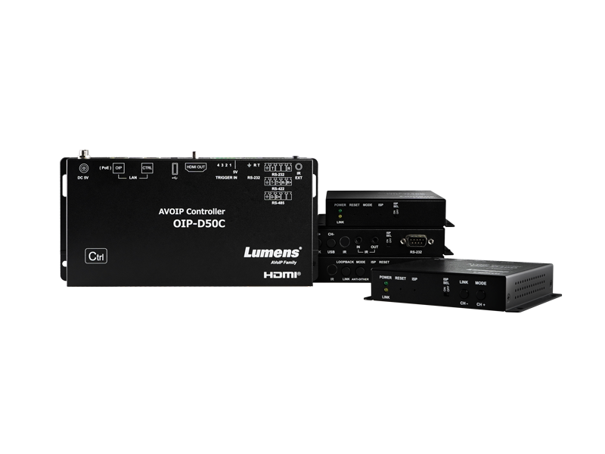
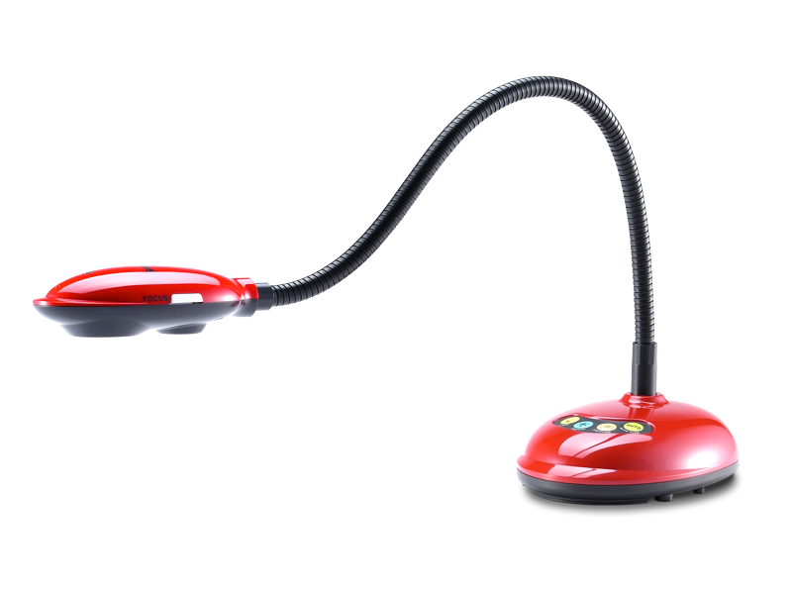
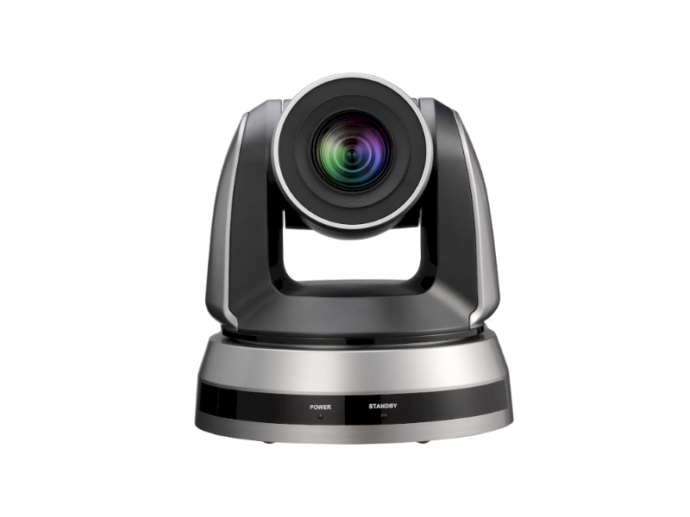
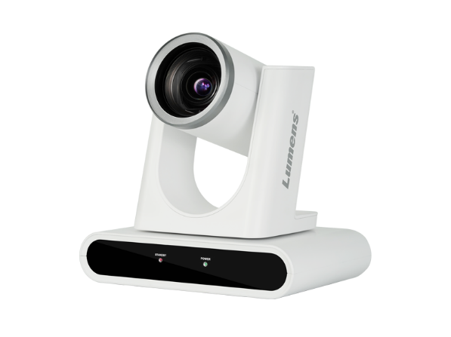
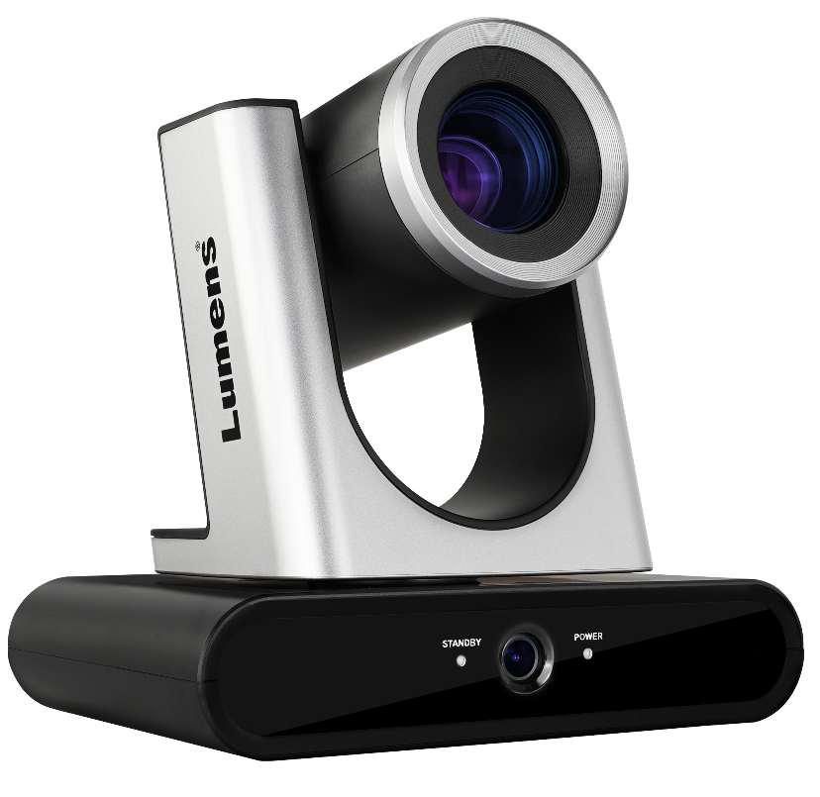

MINI FAMILY
BROCHURE
Scan for More Info.
www.MyLumens.com

Slide 2





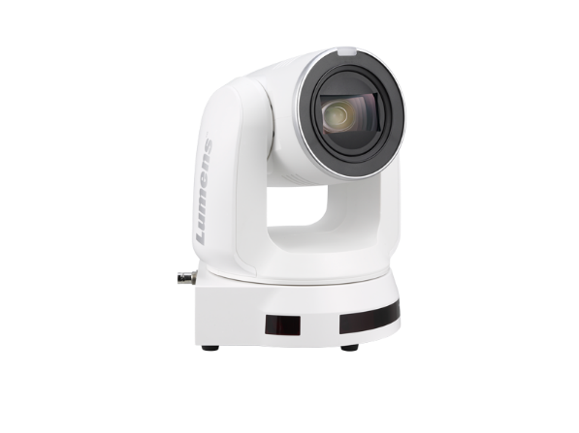
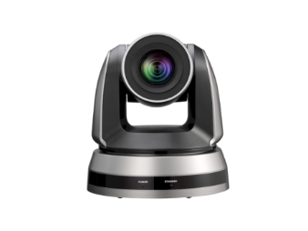
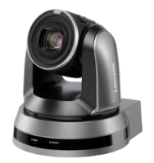

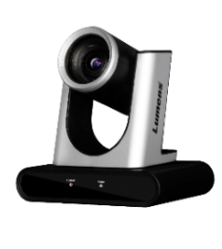
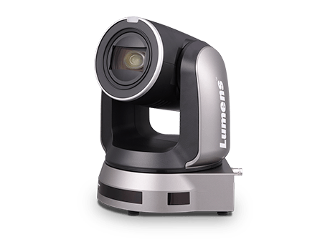

**Note:
The warranty policy, TAA and NDAA compliant may be different depending on the sales region. Changes in specification or design may be done without notification.
PTZ Camera
PTZ is an acronym for pan, tilt, and zoom. Featuring a professional camera head mounted on a robotic arm, multiple PTZ cameras can be remotely controlled by a single operator.
VC-A61P
VC-A51P
4K 30fps PTZ IP Camera
Full HD PTZ Camera
^{2160p30/1080p60, 30X Zoom}
HDMI, 3G-SDI and IP streaming output
^{Professional Sony image sensor}
^{Supports 1080p at 60fps}
^{Versatile 20x optical zoom}
PTZ Camera
VC-R30
More Info.
Full HD PTZ Camera
VC-A71P
4K 60fps IP PTZ Camera
^{1080p60 with 12X Optical Zoom}
^{Superb value for money}
Simultaneous HDMI, 3G-SDI, USB, and IP streaming output
^{2160p60 with 30x Optical Zoom}
^{AR/VR - FreeD protocol}
^{HDMI and IP streaming output}
Robotic Camera for Remote Production Workflows up-to 4K 60fps

Slide 3
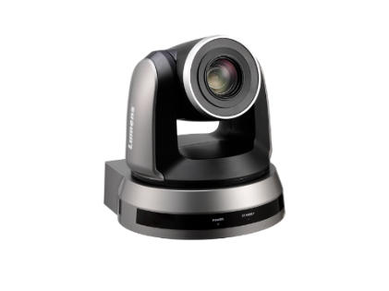
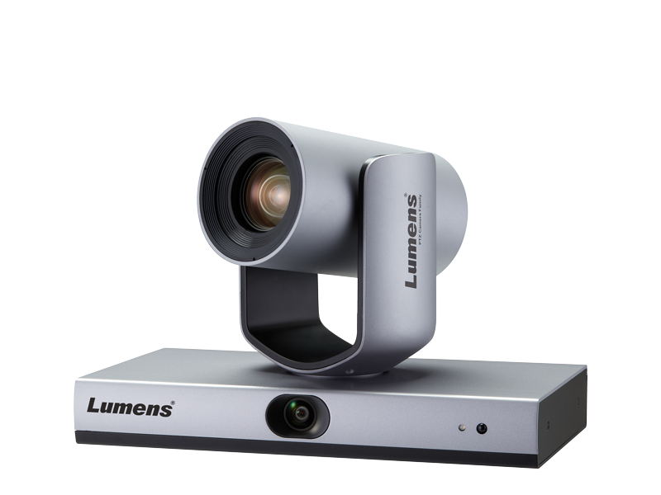
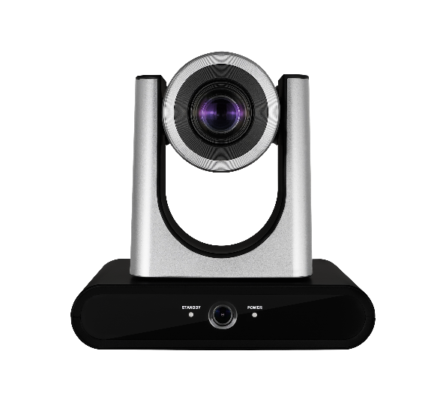
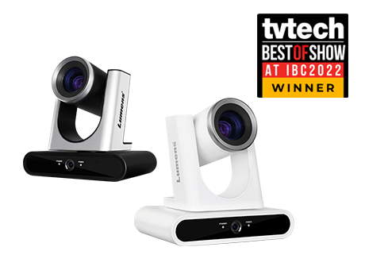

**Note:
The warranty policy, TAA and NDAA compliant may be different depending on the sales region. Changes in specification or design may be done without notification.
Auto-Tracking Camera
Auto-tracking is all about filming without the need for a camera operator. An auto-tracking camera automatically follows a presenter, lecturer or teacher autonomously.
VC-TA50
AI Auto-Tracking Camera
^{AI - Auto Tracking}
^{AR/VR - FreeD protocol}
^{Smart AF}
VC-TR40
AI Auto-Tracking Camera
^{1080p60 with 20x Optical Zoom}
3 Tracking modes and 2 Framing modes
Simultaneous HDMI, 3G-SDI, IP and USB video outputs
Auto-Tracking Camera
More Info.
VC-TR1
Auto-Tracking Camera
^{1080p60 with 20x Optical Zoom}
Auto tracking and smart switching
HDMI, 3G-SDI, IP and USB video outputs
Fully automated PTZ Cameras

Slide 4
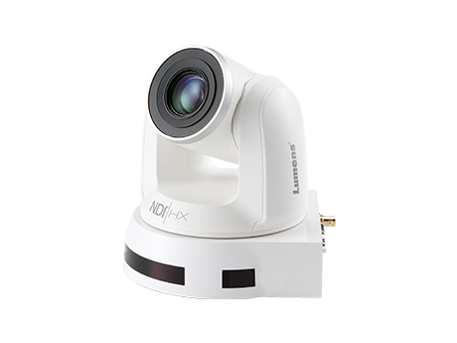
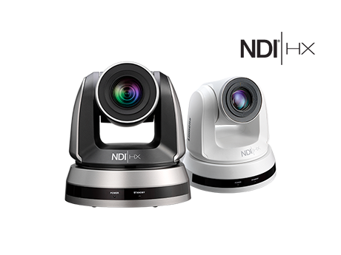
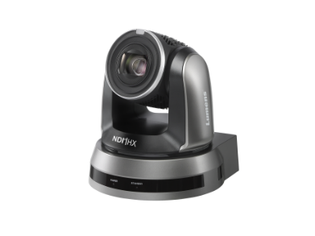
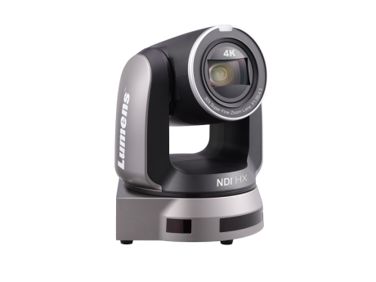
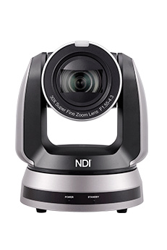
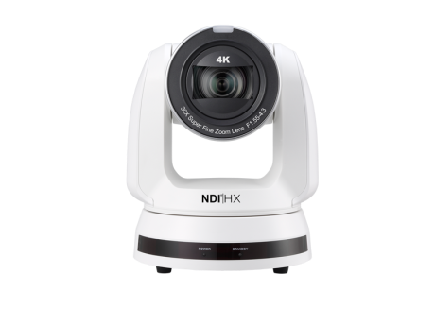


**Note:
The warranty policy, TAA and NDAA compliant may be different depending on the sales region. Changes in specification or design may be done without notification.
NDI Camera
NDI® is a network protocol that enables the distribution of high-quality video, audio and control signals over standard Ethernet networks in real-time and with minimal latency.
*NDI® is a registered trademark of the Vizrt Group.
VC-A61PN
VC-A51PN
4K NDI®|HX PTZ Camera
FHD NDI®|HX PTZ Camera
^{2160p30/1080p60, 30X Zoom}
^{Superb value for money}
HDMI, 3G-SDI and IP streaming output
^{Professional Sony image sensor}
^{Supports 1080p at 60fps}
Simultaneous NDI®|HX, HDMI, and 3G-SDI video output
NDI Camera
More Info.
VC-A71P-HN
VC-A71PN
4K NDI® PTZ Camera
4K NDI®|HX PTZ Camera
^{2160p60 with 30x Optical Zoom}
^{NDI|HX and Full NDI}
HDMI, 12G-SDI, 3G-SDI, USB, IP and Genlock
^{2160p60 with 30x Optical Zoom}
^{AR/VR - FreeD protocol}
^{HDMI and IP streaming output}
Producing and distributing video over IP networks

Slide 5
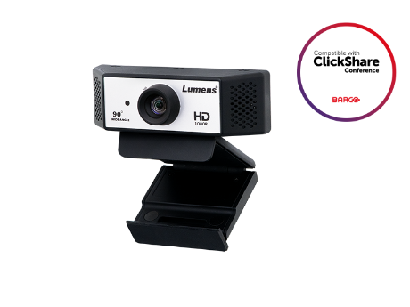
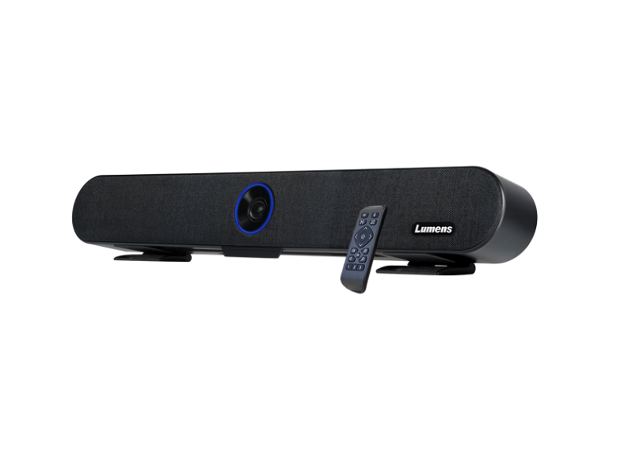
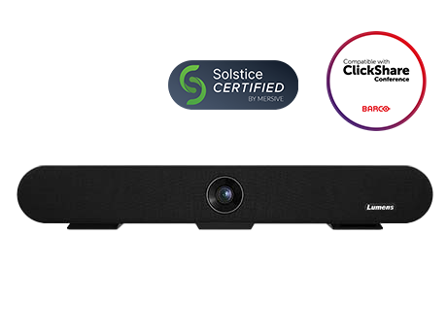
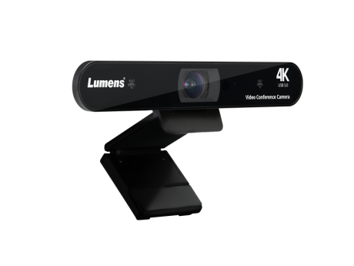
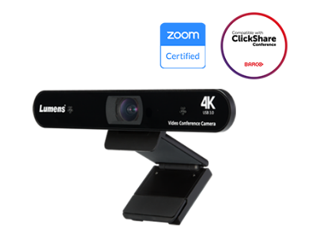

**Note:
The warranty policy, TAA and NDAA compliant may be different depending on the sales region. Changes in specification or design may be done without notification.
Video Conference Camera
While built-in laptop cameras and consumer video conferencing cameras work with most platforms (such as Skype, Teams, Zoom, and Webex), professional VC cameras also typically offer enhanced video and audio quality, and much greater versatility.
VC-B2U
Full HD 90° FOV Webcam
Full HD 1080p premium video quality
Wide 90° field of view angle to capture 1-3 video conference guests
Dual microphones pick up voices from every angle
MS-10
4K Video Soundbar
Video Conference Camera
Complete voice and video VC system
^{4K sensor with auto-framing}
Designed for monitor or wall mounting (TV mounting kit included)
More Info.
VC-B11U
4K USB Conference Camera
^{Zoom Certified USB camera}
Clear images with 4K sensor and WDR
Effectively capture human voice up to 5 meters
Webcams, huddle room cameras and integrated video soundbars

Slide 6
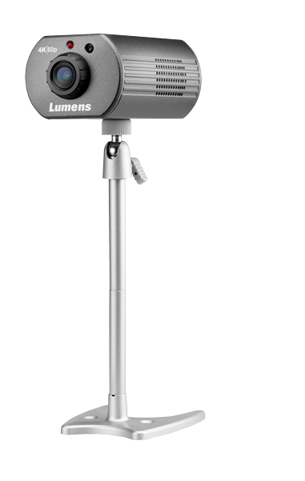
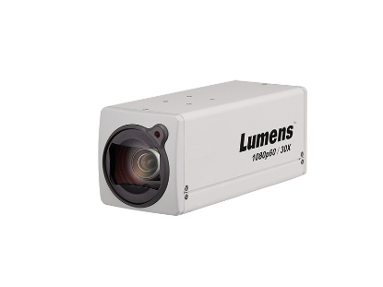
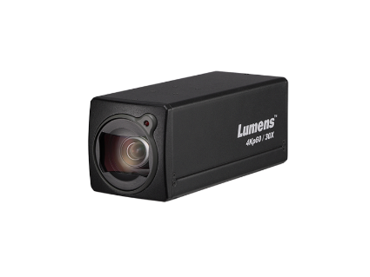
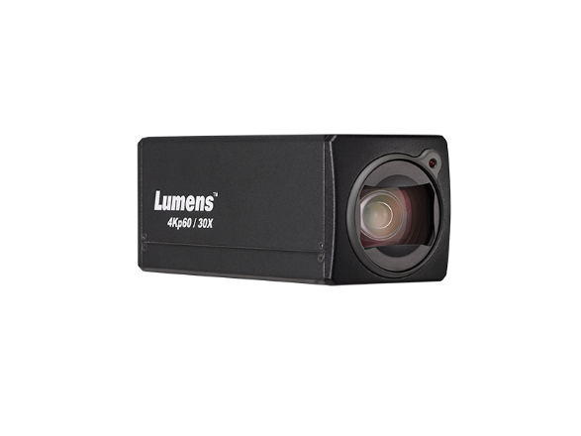
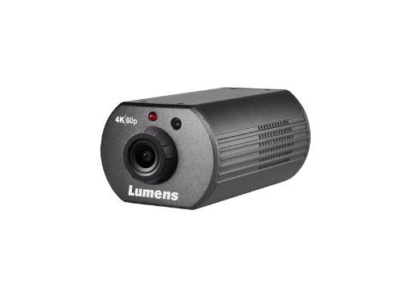

**Note:
The warranty policy, TAA and NDAA compliant may be different depending on the sales region. Changes in specification or design may be done without notification.
Box Camera
Box cameras are also known as mini cameras, minicams, or POV (point of view) cameras. They are designed for capturing specific camera angles or establishing a wide view.
VC-BC601P
1080p Box Camera
^{1080p60 with 30x Optical Zoom}
^{68° Wide Viewing Angle}
^{Simultaneous HDMI, 3G-SDI}
^{and IP streaming output}
VC-BC701P
4Kp60 Box Camera
^{2160p60 with 30x Optical Zoom}
^{68° Wide Viewing Angle}
Simultaneous HDMI and IP streaming output
Box Camera
More Info.
VC-BC301P
4K IP POV Camera
^{2160p60}
Compact Design with Tally Light
^{102° Wide Viewing Angle}
Compact Minicams with Integrated Lens

Slide 7

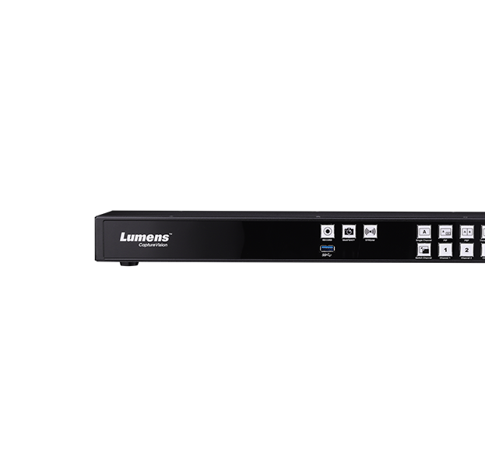
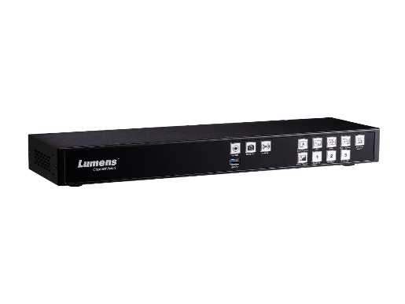
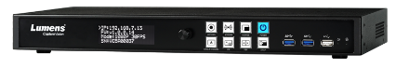
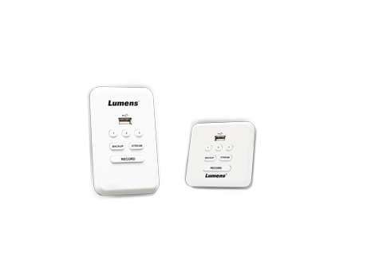
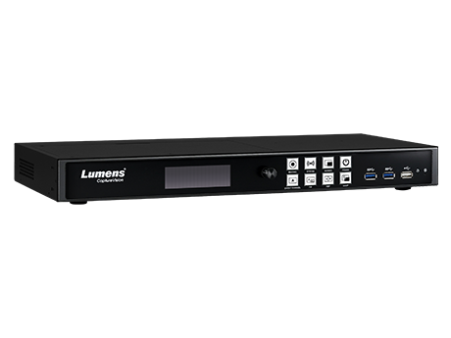
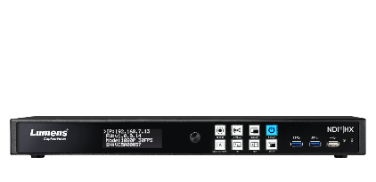

**Note:
The warranty policy, TAA and NDAA compliant may be different depending on the sales region. Changes in specification or design may be done without notification.
Media Processor
A media processor is an all-in-one station that can produce, record, and stream audio-visual presentations and multi-camera productions.
LC100
Media Processor
^{2 Channels Media Processor}
^{2*HDMI, 2*SDI, IP, USB, XLR}
^{Friendly Director Interface}
LC200
Media Processor
^{4 Channels Media Processor}
^{2*HDMI, IP and USB}
Full Panopto integration and Crestron control
Media Processor
More Info.
LC100N
Media Processor
^{2 Channels Media Processor}
^{2*HDMI, 2*SDI, IP, USB, XLR}
^{Supports NDI|HX}
Multi-channel switcher, recorder, and live streaming processor

Slide 8
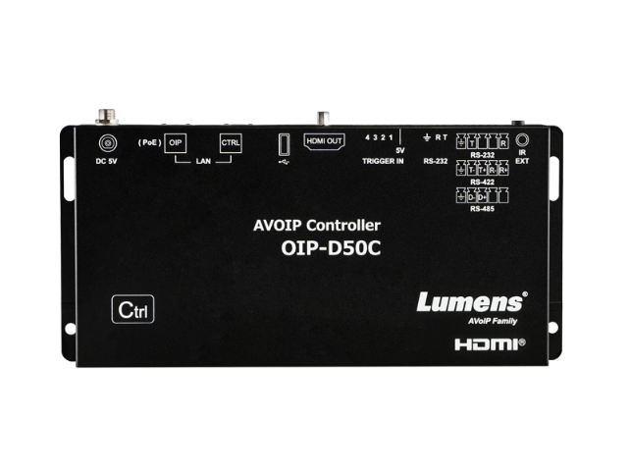
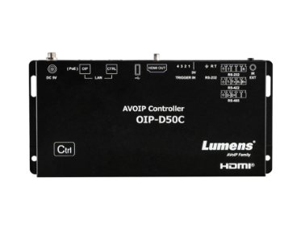
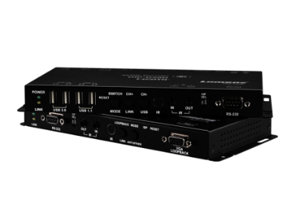
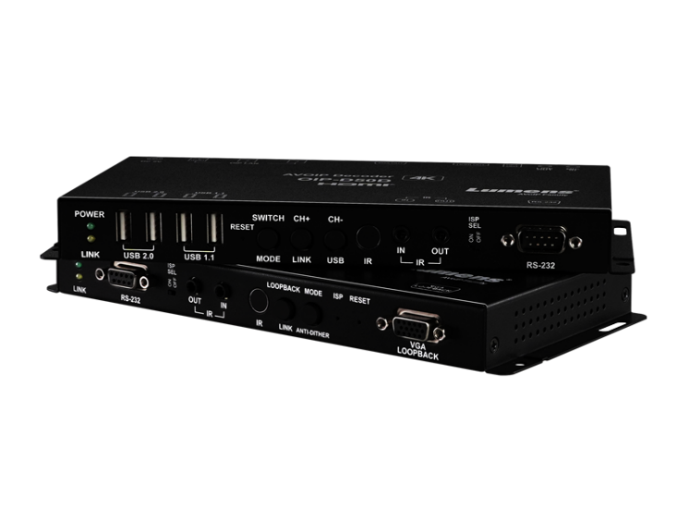
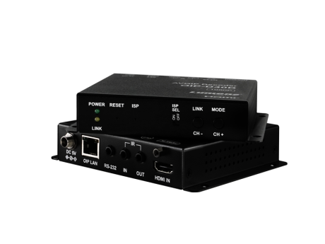

**Note:
The warranty policy, TAA and NDAA compliant may be different depending on the sales region. Changes in specification or design may be done without notification.
AV over IP
A media processor is an all-in-one station that can produce, record, and stream audio-visual presentations and multi-camera productions.
OIP-D50C
Controller
Centralized management of Lumens OIP series encoders and decoders
Controls matrix switching, video wall deployment, and KVM* connections
OIP-D50E / OIP-D50D
1G Encoder & Decoder
^{High Quality 4K Transmission}
^{Networked AV}
Extremely low-latency AV transmission and KVM solution
AV over IP
More Info.
OIP-D40E / OIP-D40D
1G Encoder & Decoder
HDMI to IP distribution with support for 1080 60p video
Extremely low-latency AV transmission
Transmits USB and serial control over IP
The future of video networking and distribution

Slide 9
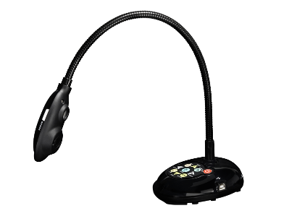
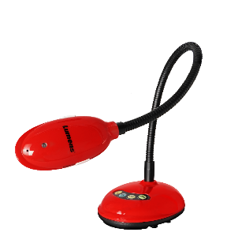

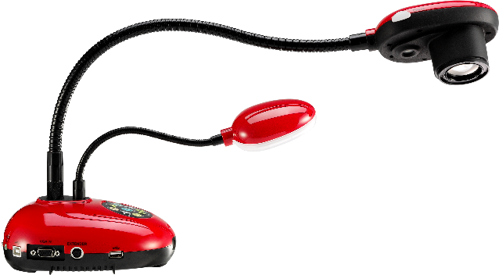
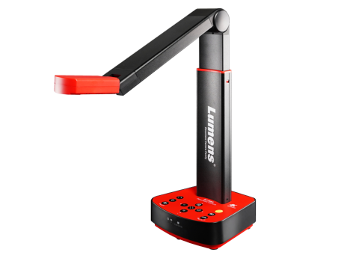
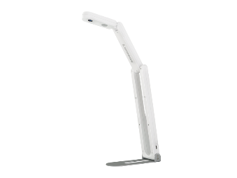


**Note:
The warranty policy, TAA and NDAA compliant may be different depending on the sales region. Changes in specification or design may be done without notification.
Document Cameras
Document Camera is easy to move from one location to another and simple installation.
It's perfect for collaborative training and distance learning.
DC193
DC132U
20x Document Camera
HD/2K USB Document Camera
^{1080p 30fps}
^{Flexible Gooseneck Design}
^{VGA and HDMI Output}
^{Built-in microphone}
^{1080p 30fps}
^{USB Plug & Play}
^{16x Total Zoom (via Software)}
^{Macro filming video from 4cm}
Document Cameras
More Info.
DC-F20
DC-W80
HD/2K USB Document Camera
4K Wireless Document Camera
^{Plug & Play}
ePTZ up to 16x Total Zoom (via software)
^{> A3 shooting area}
^{Built-in Microphone}
^{Visualizer and Webcam}
^{Support Wi-Fi 2.4G and 5G}
^{WiFi / HDMI / USB output}
^{3 Brightness Levels LED Lamp}
High-Performance Live Presentation Visualizer Compliant with Lumens Ladibug Software

Slide 10
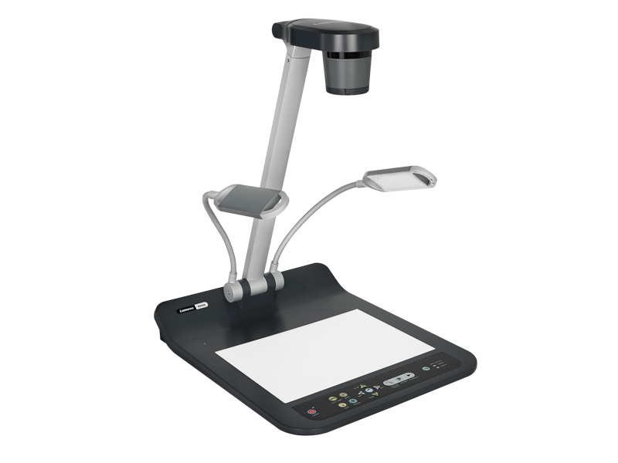
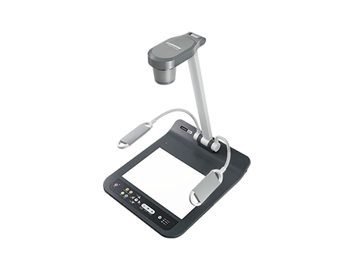
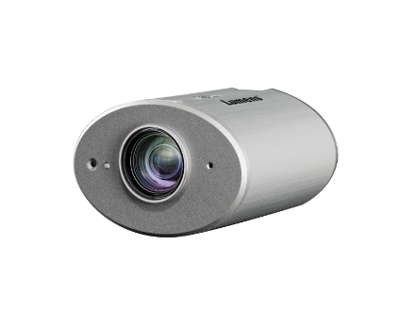
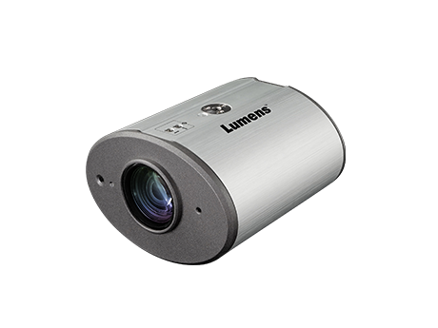


**Note:
The warranty policy, TAA and NDAA compliant may be different depending on the sales region. Changes in specification or design may be done without notification.
Desktop / Ceiling Document Camera
Desktop Document Camera is extremely versatile, capable of reproducing documents and objects larger than A3 in size. The Ceiling Document Camera is designed to be suspended from or embedded into the ceiling to provide an overhead view of a demonstration area.
PS753
Desktop / Ceiling Document Camera
4K Desktop Document Camera
^{4K Resolution with 300x zoom}
^{HDMI (IN & OUT), VGA,}
^{Ethernet (PoE+) and USB output}
^{Records to USB drives}
More Info.
CL511
4K Ceiling Camera
^{2160p30 with 300x Total Zoom}
^{PoE+}
^{Laser Mark Central Position}
High-Performance Live Presentation Visualizer Compliant with Lumens Ladibug Software

